Slide 1

ONLINE PET SHOP

Slide 2
ABSTRACT
This project is aimed at developing a website that depicts online shopping for PETS.
The main objective of this website is to make it interactive and its ease of use , view the complete description of the PETS and order the PETS.
It integrates the benefits of an ordering products with the convenience of an online excitement and going with the technology,minus the commuting hazards and expenses.
It provides a means of collaborative E-ordering for the customers

Slide 3
MODULES
Customer Registration
Customer Log-In
View Products
Product Booking
View Booking Details

Slide 4
SCOPE & PURPOSE
Scope:
Provide Interactive interface through which a user can interact with different areas of application easily.
It is not intend to a particular organization .More over it provides facility to its Customer.
The main scope of this project is to enhance and upgrade the existing system by increasing its efficiency and effectiveness. The web based application improves the working methods by replacing the existing manual system with the computer-based online system.
Purpose:
To manage the online Pet shop ordering. It helps customer to book Pets from anywhere .
Also make payment on delivery .It helps to people book desired Pets at their prefer time

Slide 5
PORPOSED SYSTEM:
The proposed system ensures the complete freedom for users, where user at his own system can logon to this website and can book his product.
Our proposed system allows only registered users to book the Pets ,view booking or cancel as per their requirement.
In this Proposal the entire work is done online.

Slide 6
SOFTWARE USED:
Eclipse IDE
VS-Code
My-SQL [Database]
Server:
Apache Tomcat Server

Slide 7
FRONT END:
HTML(Hypertext Markup Language)
CSS(Cascading Style sheet)
BOOTSTRAP(Library of HTML,CSS and JS)
BACK END:
JDBC(Java Database Connectivity)
SERVLETS
JSP(Java Server Pages)

Slide 8
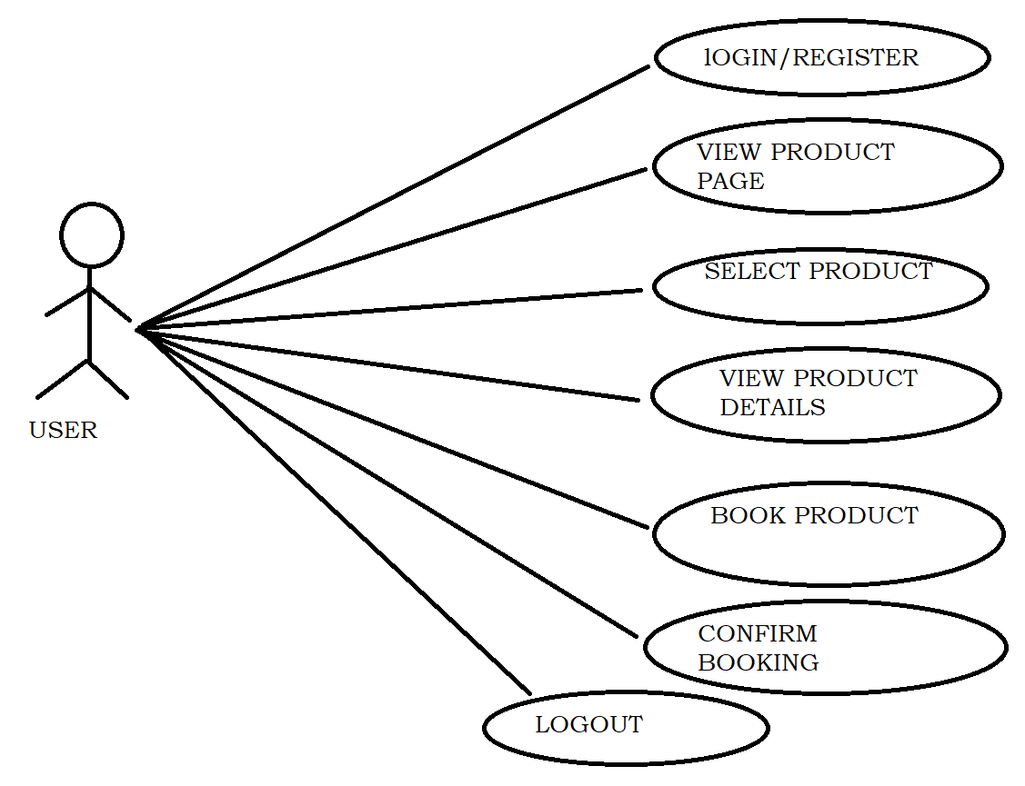
USECASE-DAIGRAM:

Slide 9
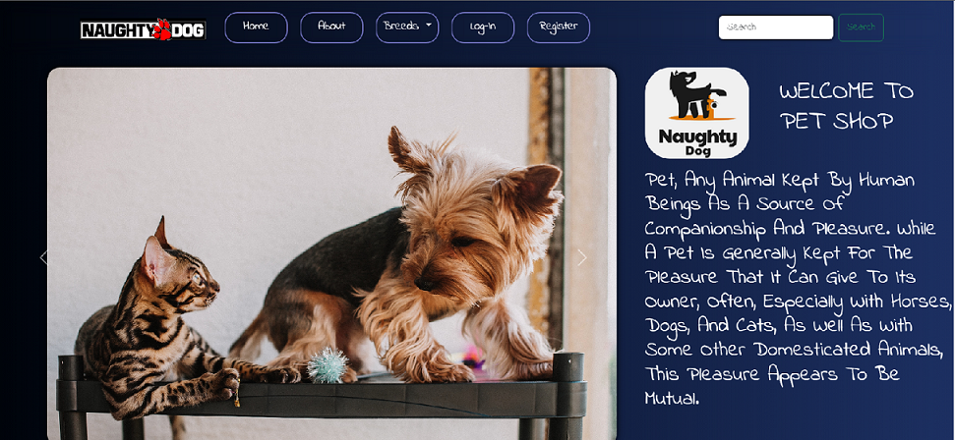
HOME PAGE:

Slide 10
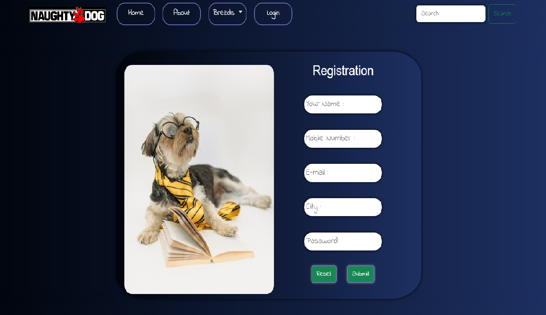
REGISTRATION PAGE:

Slide 11
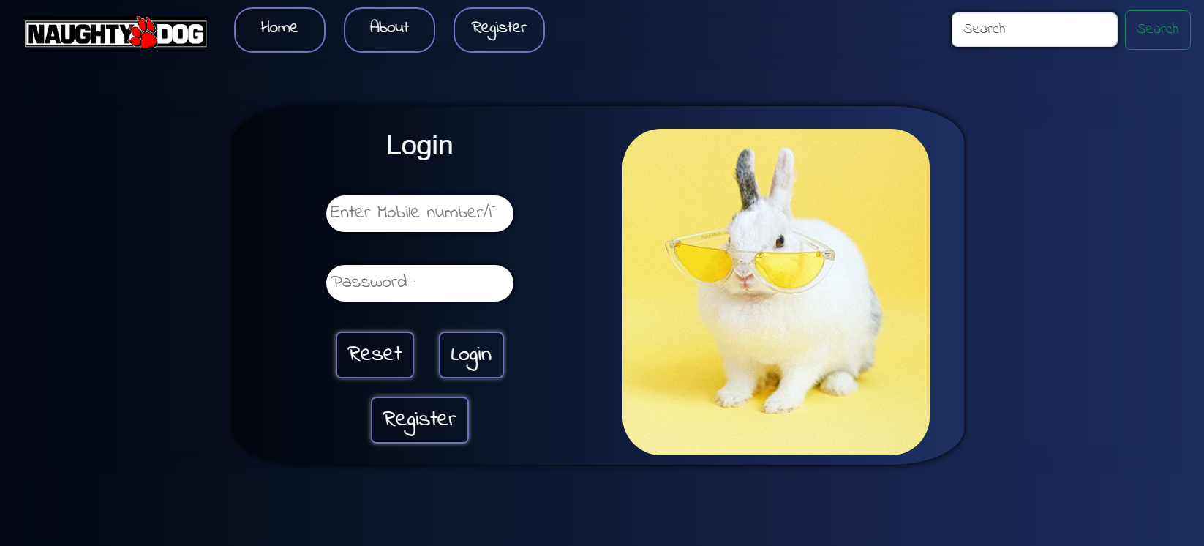
LOG-IN PAGE

Slide 12
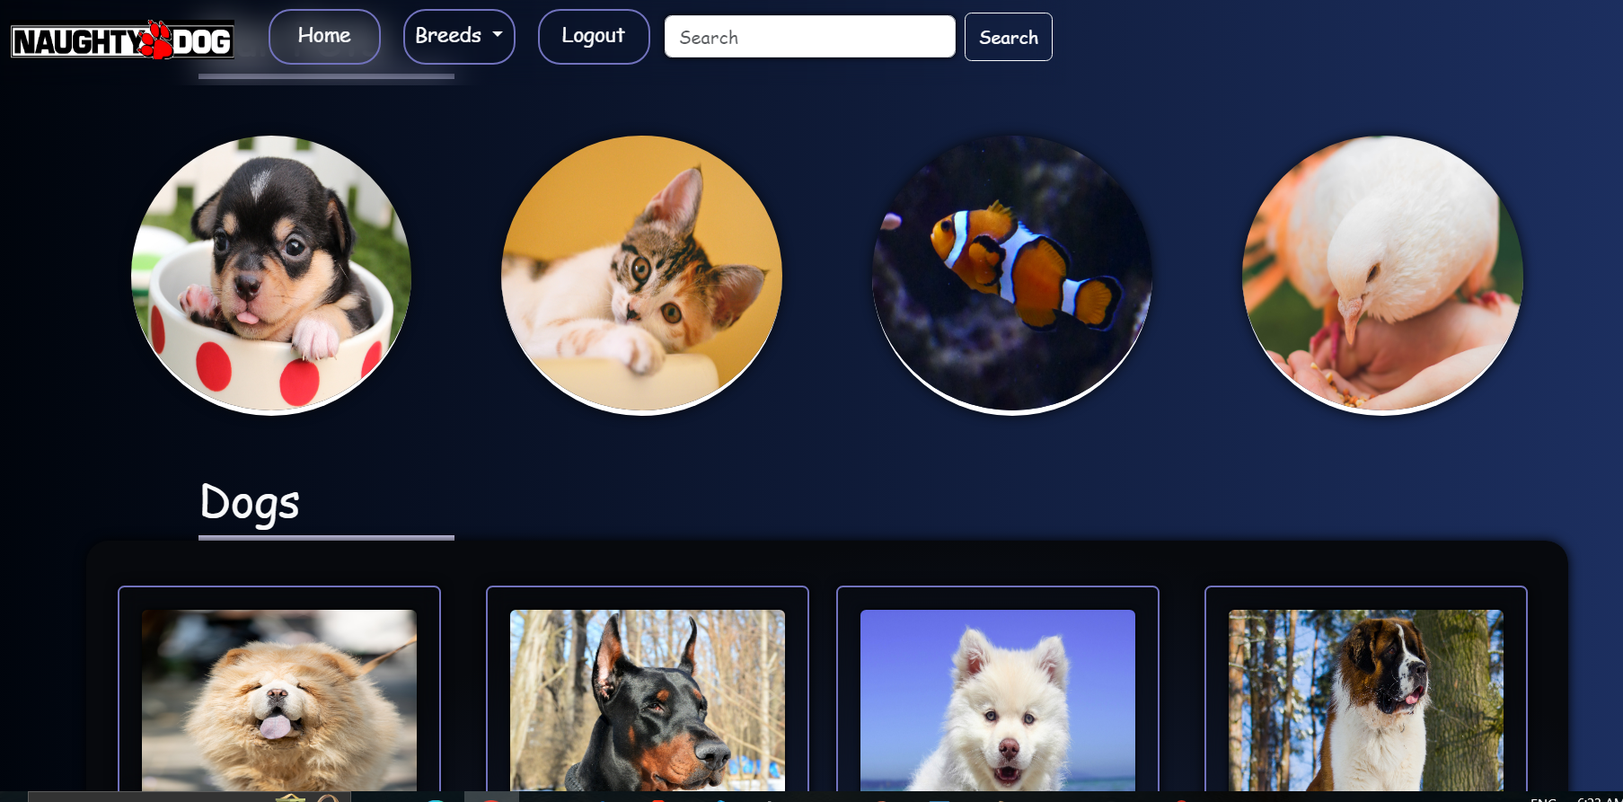
PRODUCTS PAGE:

Slide 13
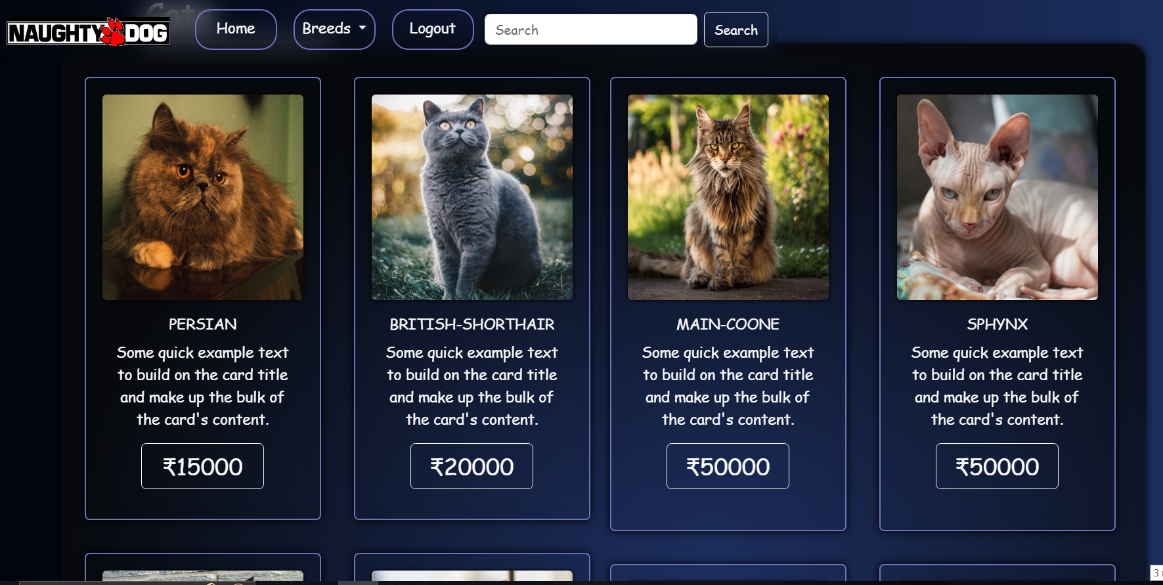
PRODUCT BOOKING CARD PAGE:

Slide 14
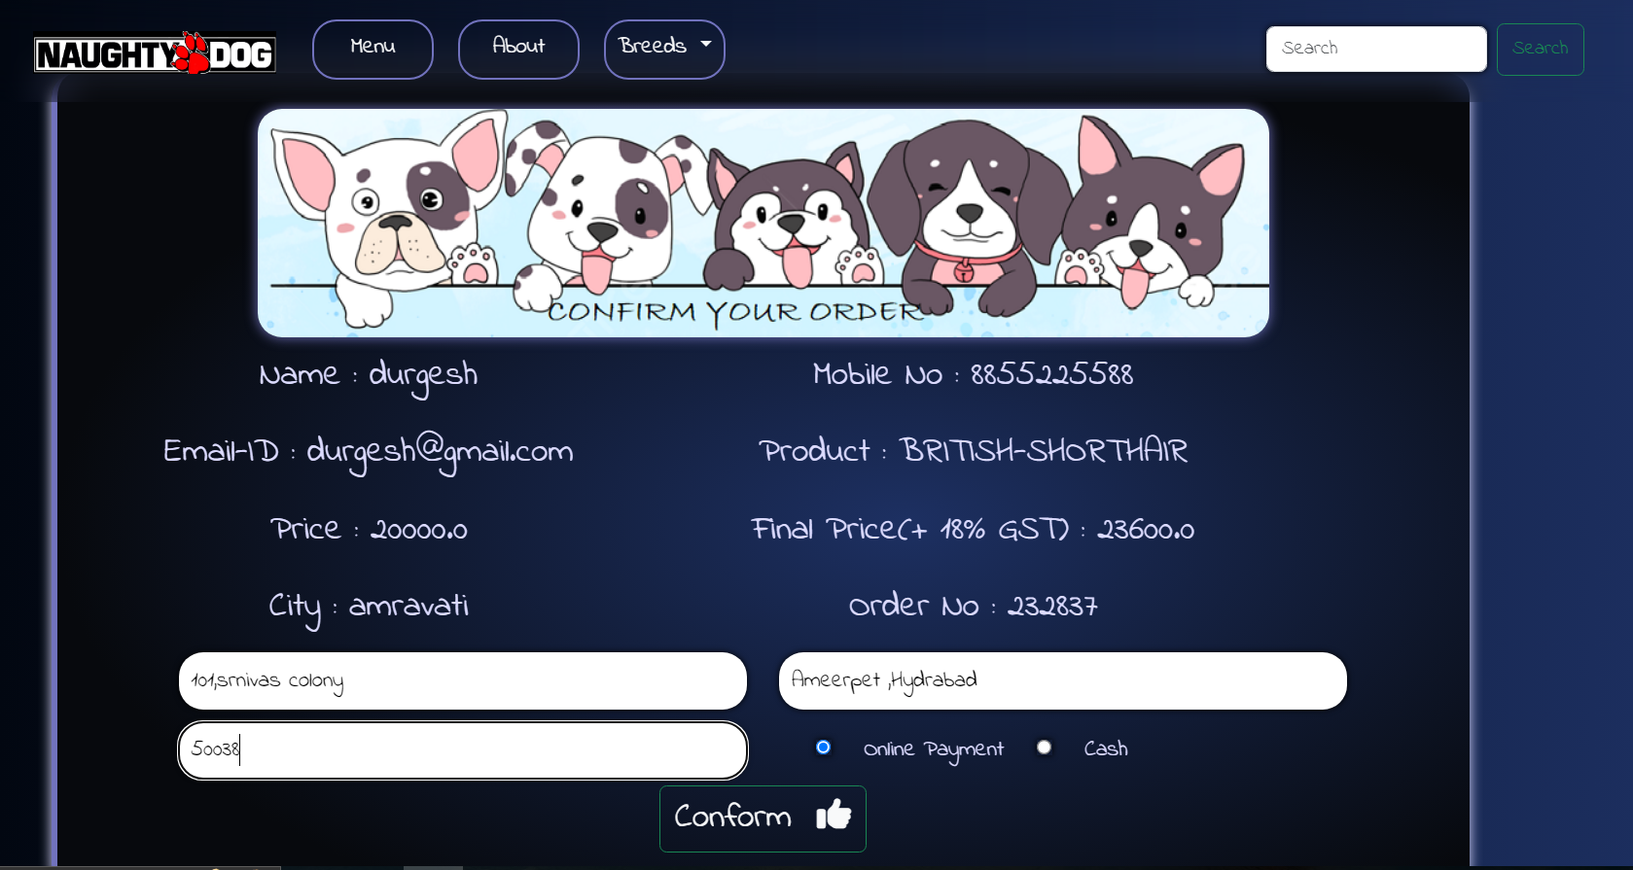
BOOKING DETAILS PAGE

Slide 15
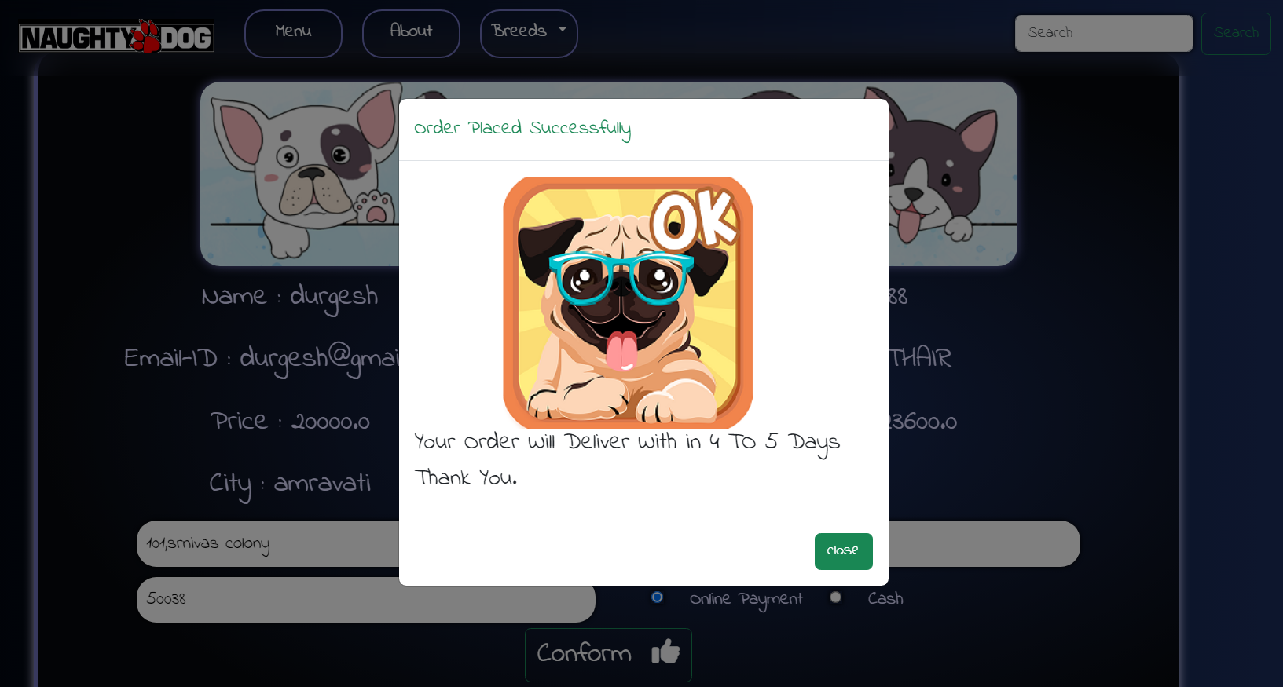
BOOKING CONFIRMED PAGE:

Slide 16
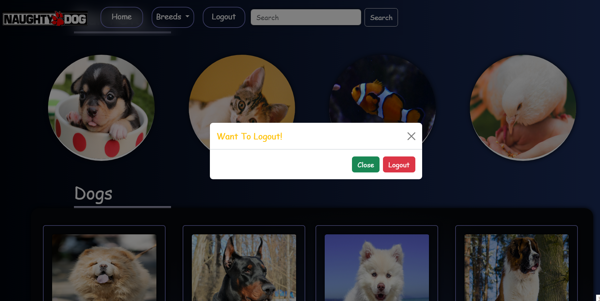
LOGOUT:

Slide 17
CONCLUSION:
We feel that our business will be successful and we will be able to meet the needs of our customer and given then a 100% satisfied service.
Making the name of our business in the country is our target. We will put our best to make this business a successful one. We are looking forward to cover up all our expenses as mentioned in the financial part and achieve our goals in the proper way.
Our business is not so big, we are very much hopeful that we will be successful one.

